Slide 1
ME 170 Lab 1
Understand Space
Sit with your team! Come to the front to look at the team roster

Slide 2
Learning Objectives
After this lab you should be able to...
Identify unmet needs
Employ techniques for empathetic interviewing
Differentiate between a needs-oriented approach and a solution-oriented approach

Slide 3
Intro to Human Centered Design (Video)
Notes:
Video should be played for lab sections before the Intro lecture

Slide 4
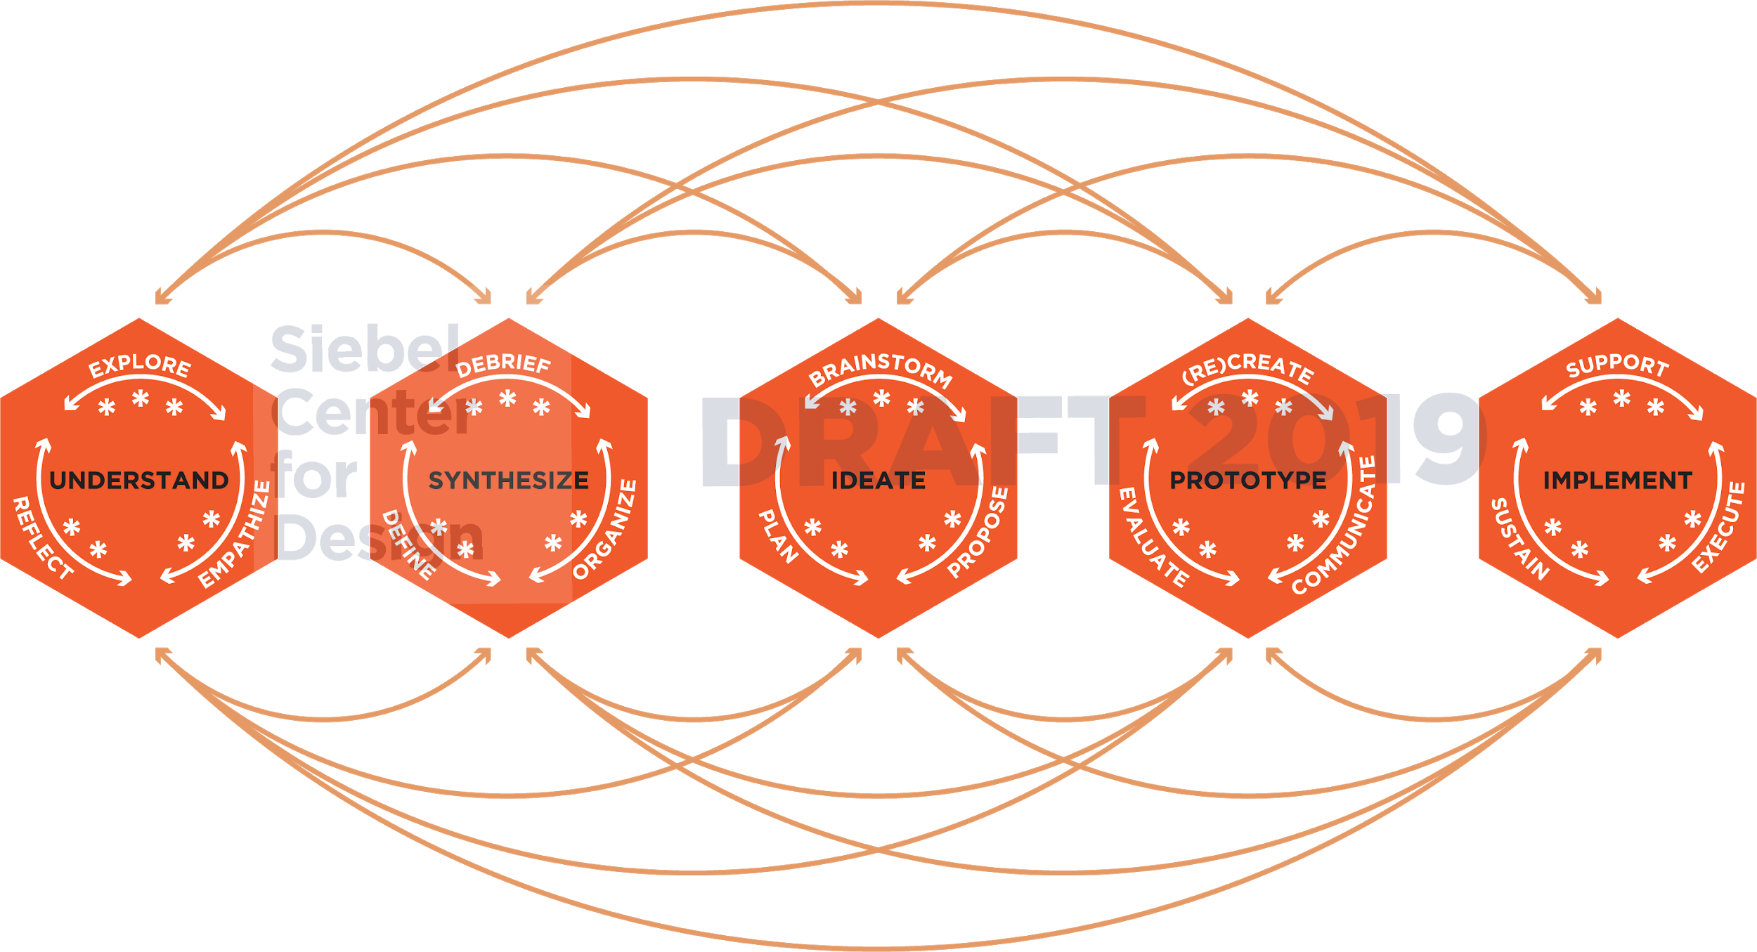
Notes:
During the UNDERSTAND space, designers will
Explore
Establish a common problem space
Review current landscape or context
Document their biases and predictions
Empathize
Interview
Observations
Immersive Observations (location, community, context)
Locate resources
Identify extreme users
Reflect
Reflect on their biases
Reflect on the projects’ motivations
Reflect on stakeholders’ needs

Slide 5
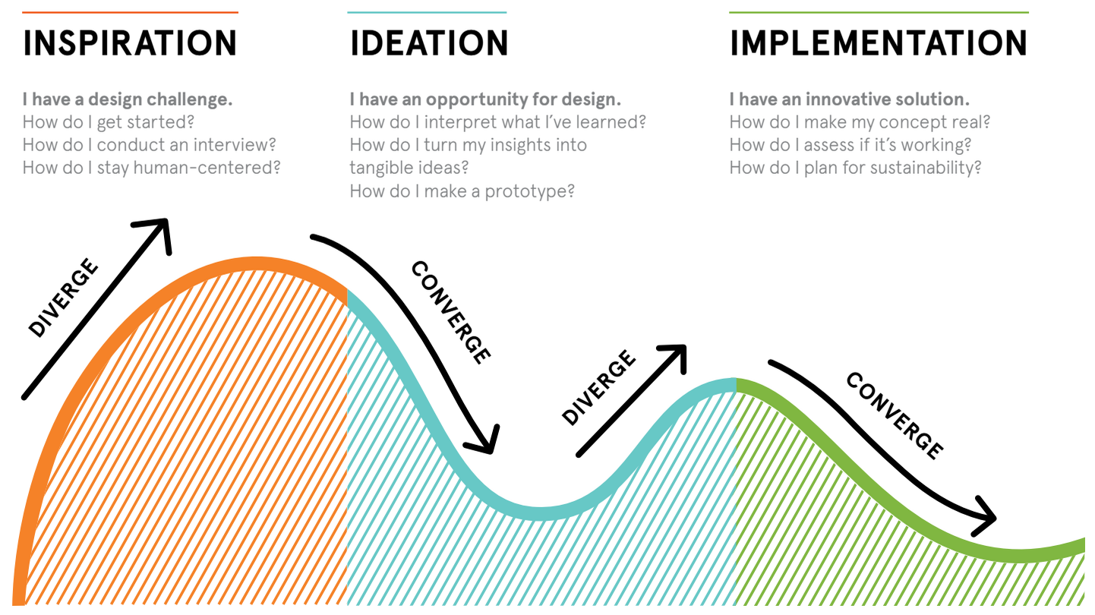

Slide 6
Notes:
This lab focuses on the "Inspiration" phase and understanding how to identify unmet needs. This is intended to help students find more meaningful project topics for the semester project

Slide 7
Icebreaker!
Notes:
Since you’ll be working with your teammates for the rest of the semester, we might as well break the ice.

Slide 8
Write down at least 10 objects...
Partner A
you might find in your “junk drawer” or that one spot in your dorm or home that just seems to accumulate stuff
Partner B
you might find in a convenience store like CVS or Walgreens

Slide 9
Write down at least 10 objects...
Partner A
something you might find in a tool box
Partner B
you might find in a in a grocery store

Slide 10
Now share your lists with each other
“Mash-up” objects from each list to create a new product. Make it fun and give it a name!

Slide 11
Find another team nearby and share your favorite mash-up with them!
What’s the best or funniest or wackiest mash-up that you heard?

Slide 12
Class Project

Slide 13
Class Project
Design a mechanical or electro-mechanical product to address unmet needs related to food on campus
What
For whom
Context
Goals
Assumptions
Notes:
Food delivery
Food storage
Food prep

Slide 14
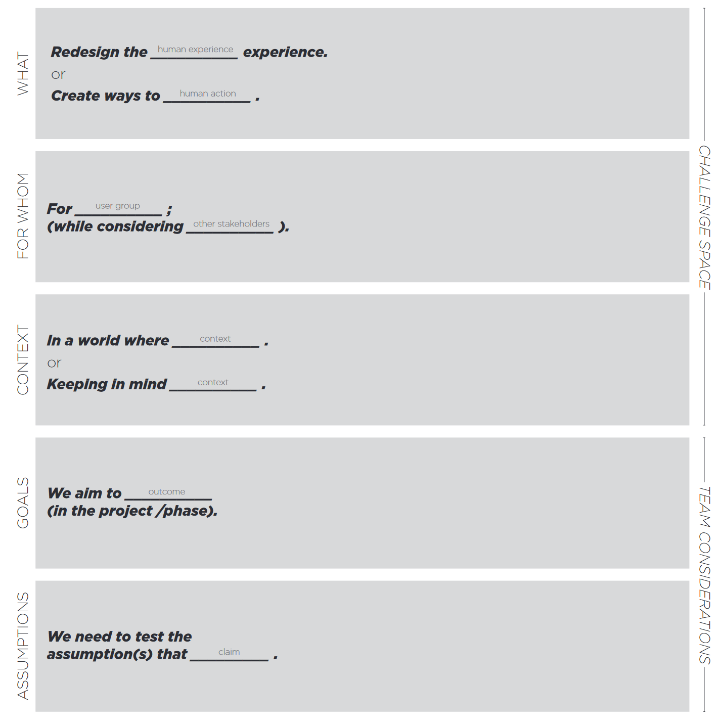

Slide 15
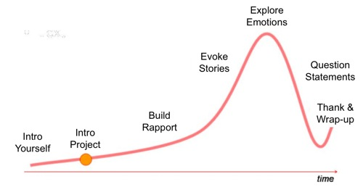
Arc of an Interview
Notes:
What is the person you’re observing doing in a particular situation? Note the obvious as well as the surprising. Just report the objective facts.
How are they doing it? Does it require effort? Does they appear rushed? Pained? Happy? Is the activity impacting the user in either positive or negative way?
Why are they doing what they’re doing, in the way they’re doing it? This step usually requires that you make informed guesses regarding motivation and emotions. This step will reveal assumptions that you should ask users about, and often uncovers unexpected realizations.
Look for inconsistencies. Sometimes what people say and what they do (or say later) are different. Gracefully probe these contradictions.

Slide 16
Before the Interview
Identify who you want to interview
Extreme users
Seek many, varied perspectives
Prepare open ended, neutral questions
Seek out stories

Slide 17
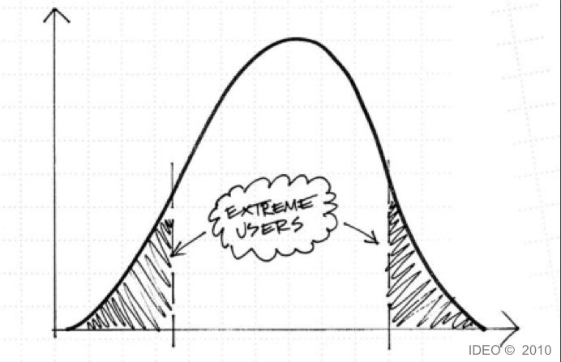
“Extreme” Users
Notes:
We can design for middle part but we can innovate for those on the edges
They have a unique experience that’s really really valuable
The extreme could be a consistent attribute or a temporal situation. For example, for an air travel design challenge, extremes might include: - A family with young children flying - Someone who is scared of flying - Someone who uses the wheelchair services - A foreigner who doesn’t speak the local language - Someone who commutes by plane - Someone with a short connection time - Someone with oversized or precious baggage

Slide 18
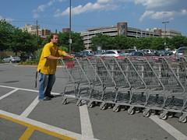
Extreme Users
Denizen8 | flickr
Notes:
Left: xbox adaptive controller for people with disabilities
Right: 3D printed accessory for xbox controller to help with steering games (https://www.slashgear.com/xbox-one-controller-mod-adds-a-3d-printed-mini-steering-wheel-16541514/)

Slide 19
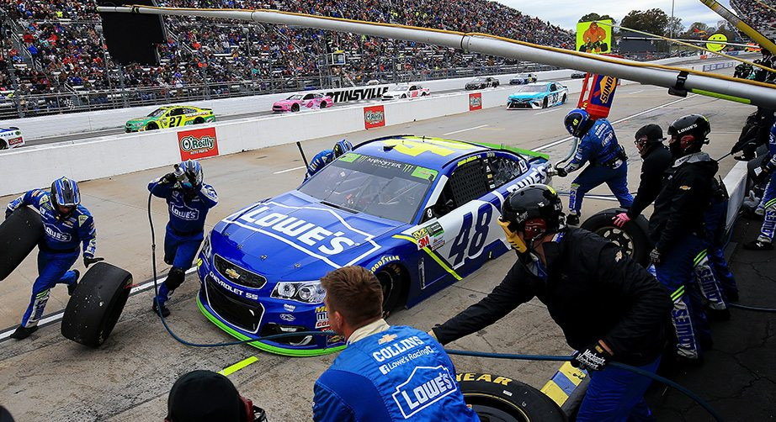
Analogous Experiences
Where can you go to have an inspiring experience related to your challenge?
What are analogous settings or extreme experiences where you might witness similar or relevant behaviors and activities in a different context?

Slide 20
Before the Interview
Identify who you want to interview
Extreme users
Seek many, varied perspectives
Prepare open ended, neutral questions
Seek out stories
Decide roles during interview
Interviewer
Note-taker
Photographer
Consider what kind of information you want to capture and how
Sketching, bullet notes, photos, audio recording

Slide 21
Know Your Strengths
How do you build rapport?
Funny? Quiet? Relatable? Inquisitive?
If you need more prep before interviews take that time!
You don’t have to wing it to be successful
If you think you don’t, you still probably do
Different people have different perspectives. That’s what makes teams strong.
Need extra help? Contact Alex: apagano2@illinois.edu

Slide 22
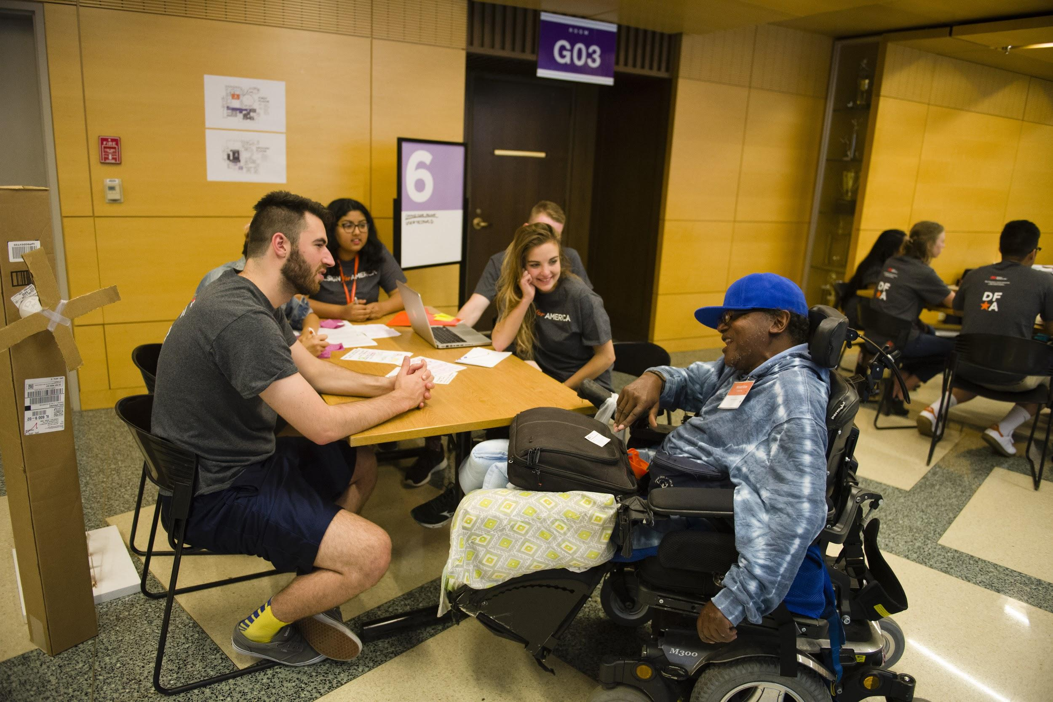
During the Interview
Build Rapport
Be human
Talk about feelings
“Can you tell me more about…”
“Why did you choose to do that?”
Write down exactly what they say
Don’t assume to know what they intended
Observe context of the setting
What does their room look like? What does this mean?
Seek stories
Experiences uncover actionable insights
Notes:
Seek stories example:
“the RAs were very well organized and helpful” versus “my RA helped me find out how to switch our beds to bunk style and made me feel like I had someone on our side right from the start”. The later shows a desire for a personal connection/support system from day 1 of move in, rather than just a need for organization like the first comment.
Have the interviewee show you around your room, what they did during move in. Get them active

Slide 23
Interview Tips
Always say yes to an offer
Treat people like partners in research
Leave comfortable silences
Take the spotlight off the other person, seek common ground
Ask “WHY”
Try very intentionally to fall in love with each person (even if it’s just a little bit)
Notes:
https://www.ideou.com/blogs/inspiration/6-tips-from-ideo-designers-on-how-to-unlock-insightful-conversation
When someone offers water or a seat just take the dang seat, you’re giving them a win to start off the interview. Helps them build confidence
Try to level the playing field so it doens’t feel like you’re mining them for info
Percepetion of time is vastly different. Example: teacher asking a question feels like a lot longer waiting for an answer than the students coming up with an answer. WHen you talk in class it may feel like you’ve been talking forever
Be human to each other, share your own stories
If at a loss for where to go, can always refer back and ask why/seek stories
Empathy is key to all of this

Slide 24
User research simulation
Understanding experiences and expectations of food on campus to identify unmet needs
Example baseline questions:
What’s your name?
How long have you been on campus?
Where do you typically eat? Why?
Write your own questions in the handout

Slide 25
Switch partners and repeat!
Understanding experiences and expectations of food on campus to identify unmet needs
Example baseline questions:
What’s your name?
How long have you been on campus?
Where do you typically eat? Why?
Write your own questions in the handout

Slide 26
Interview Reflection Assignment
What questions do you still have?
Would you ask different questions?
Would you approach the interview differently?
Submit here: https://forms.gle/uD7MxBZaor5V4FAJ8

Slide 27
Define a Research Goal
Goal should explain the impact you want to create
Needs oriented
Good goal: I want to improve the oral hygiene experience to reduce cases of gingivitis
Goal should not describe the solution you think is right
Solution-oriented
Bad goal: I want to redesign a new toothbrush that cleans mouths better
What are your indicators of success?
What are your constraints?
Notes:
Good goals are ones where you can brainstorm 5 very different solutions in 30 seconds quite easily

Slide 28
Solution-Oriented vs Needs-Oriented
Solution -Oriented Approach
Assumes problem is well understood
Assumes a solution exists to address the unmet needs “Alex needs an automated veggie chopper to reduce the time it takes to prepare meals”
Needs-Oriented Approach
Assumes problem is ill-defined
Seeks a solution by understanding unmet needs “Alex needs a low-tech way to reduce the time it takes to prepare meals while letting him enjoy the manual process”

Slide 29
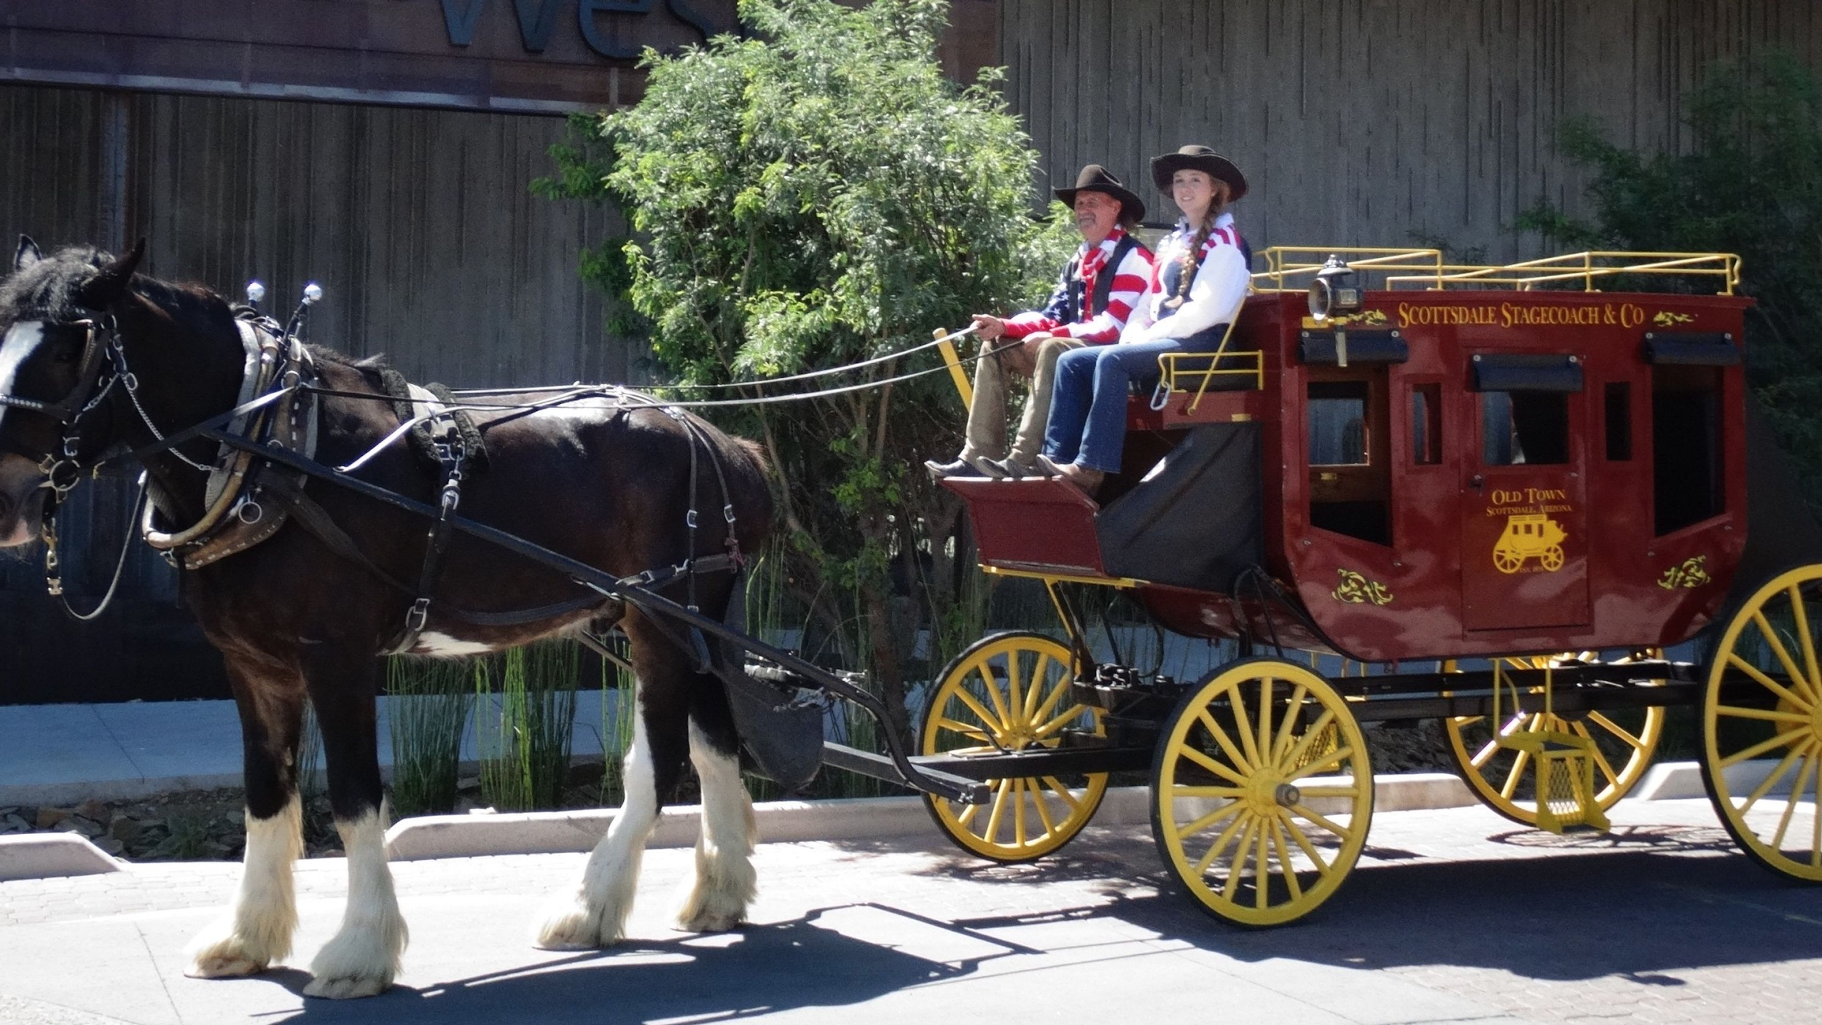
Question Initial Assumptions
“Needs outlast solutions”
Notes:
We will always need some way to get from point A to point B more quickly. If you were asked to solve this prior to the advent of the car you would likely assume that you would need to design some new upgrade to the horse and buggy system. Examining your initial assumptions allows you to call out the fact that you’d expect all designs to be related to the horse and buggy, and by calling it out you allow yourself to acknowledge (and hopefully move beyond) your internal biases. This will lead to completely out of the box solutions, like an automobile!

Slide 30
Discuss with your team:
How might we find problems related to food on campus?
Pull from your own experience and expectations
What problem area are you most interested in?
What are you most capable of addressing?
Decide scope: what/for whom/context/goals/assumptions
Notes:
Pre-interview debrief section of Lab 1 “handout”

Slide 31
Interview Packet
When designing in engineering it is crucial to understand the types of unmet needs we can create for. To do this we talk to the people we’re designing for, the users. Your task as a team is to interview 3 people outside of class about your project topic.
These conversations should be at least 20 minutes. Use the following interview packet for note taking during your interviews. Remember there should be at least two team members present for these interviews: one interviewer and one note taker. Each team member must be in at least one interview and no team member should be in all three. If you are a part of two interviews, you should not have the same role. Branch out!
Assignment: Turn in a copy of this Interview Packet, with three interviews conducted. It can be typed or handwritten and scanned in. Assignment is due by Lab 2.

Slide 32
Next time...

Slide 33
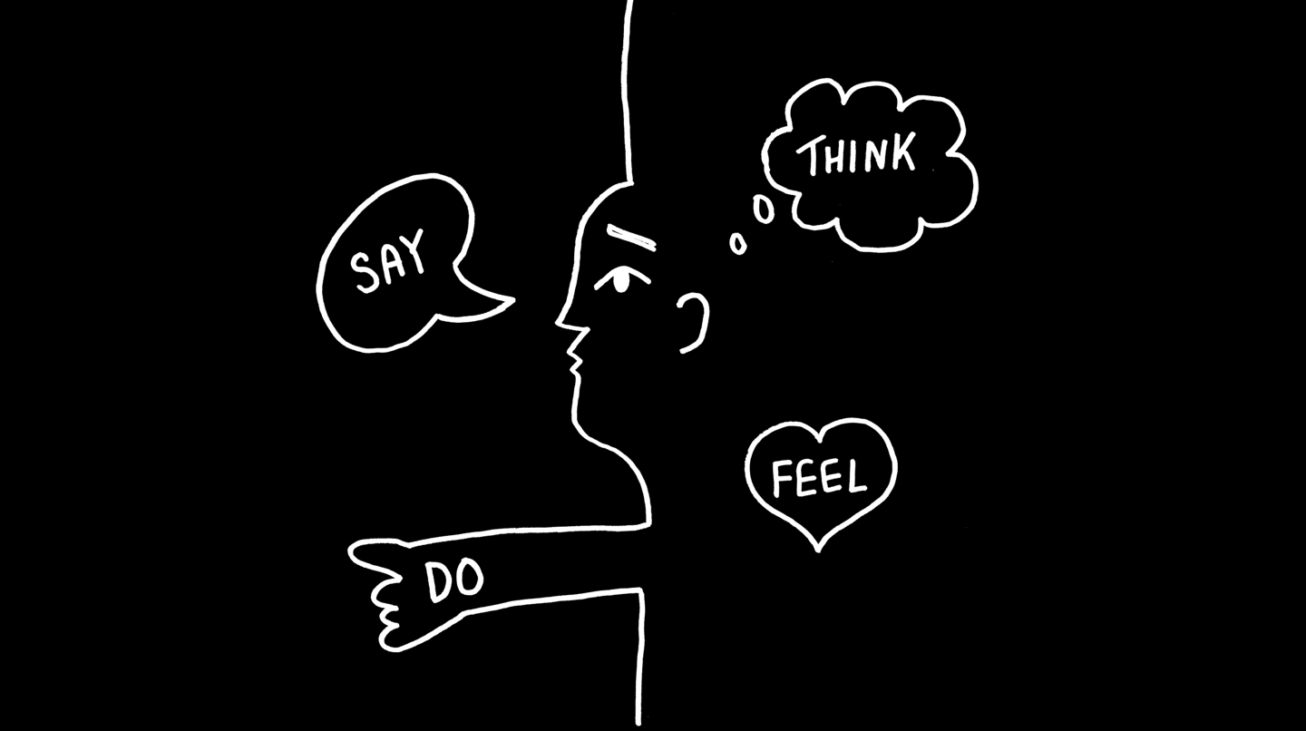
Observation
Empathy
Notes:
Lucas

Slide 34
What is Synthesis?
Act of making sense of what we’ve seen and heard during observations to come to a shared understanding
Takes us from inspiration to ideas, from stories to solutions
Enables us to establish a new perspective and identify new opportunities

Slide 35
Steps of Synthesis
Downloading interviews and observations
Identifying patterns and themes
Extracting key insights
Create frameworks visually communicate insights

Slide 36
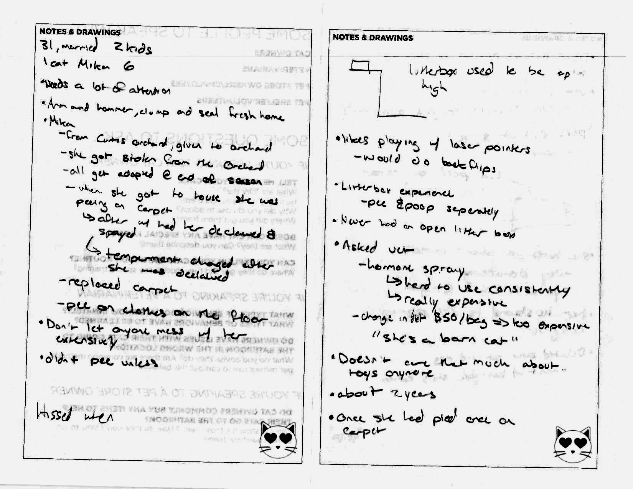
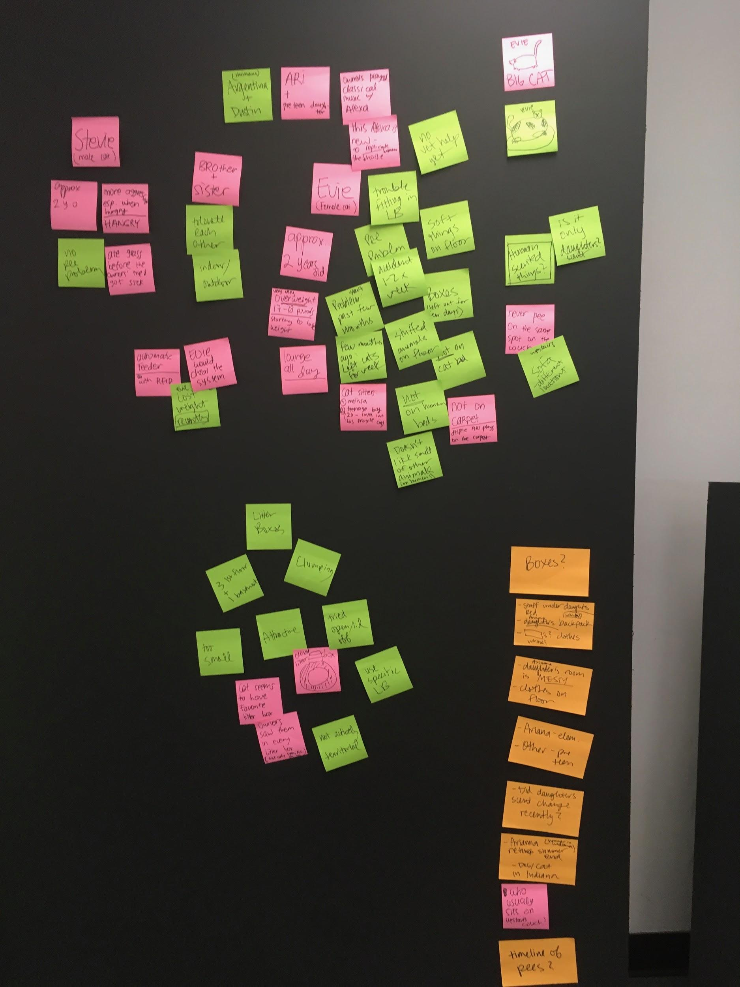
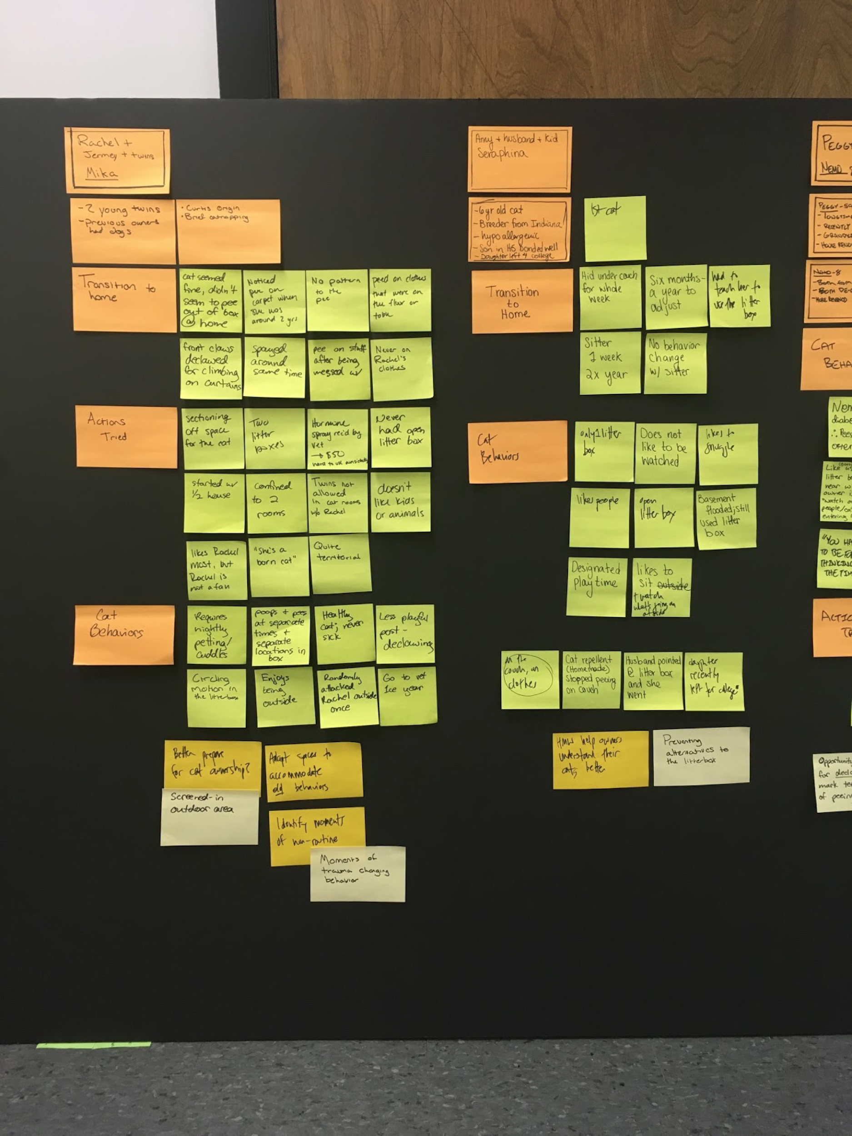

Slide 37
Interview Packet
When designing in engineering it is crucial to understand the types of unmet needs we can create for. To do this we talk to the people we’re designing for, the users. Your task as a team is to interview 3 people outside of class about your project topic.
These conversations should be at least 20 minutes. Use the following interview packet for note taking during your interviews. Remember there should be at least two team members present for these interviews: one interviewer and one note taker. Each team member must be in at least one interview and no team member should be in all three. If you are a part of two interviews, you should not have the same role. Branch out!
Assignment: Turn in a copy of this Interview Packet, with three interviews conducted. It can be typed or handwritten and scanned in. Assignment is due by Lab 2.

Slide 38
For the rest of class, work with your team:
Interview Packet
“Before the Interview”
Notes:
Getting a start on the assignment

Slide 39
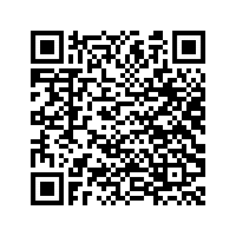
Feel free to contact SCD for help!
Alex Pagano- apagano2@illinois.edu
Siebel Center for Design- designcenter@illinois.edu
@SCDillinois
Sign up for our newsletter!

